Slide 1
Title
Week 1 – Introduction to Web Development
Dr Fatmaelzahraa Eltaher
Date, Module name, Lesson number
Web Development 1

Slide 2
Learning outcomes for this lesson
The Internet and the Web
The purpose of websites
Client-side and server-side
The components of a website

Slide 3
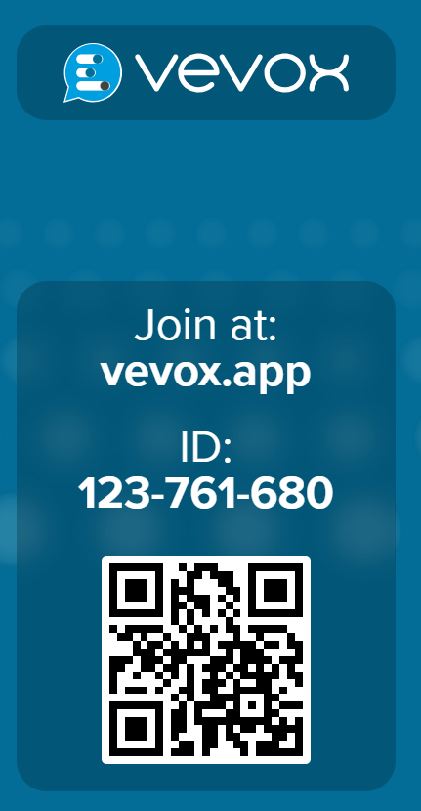
Title
What is the Internet?
Vevox - Present view
Date, Module name, Lesson number

Slide 4
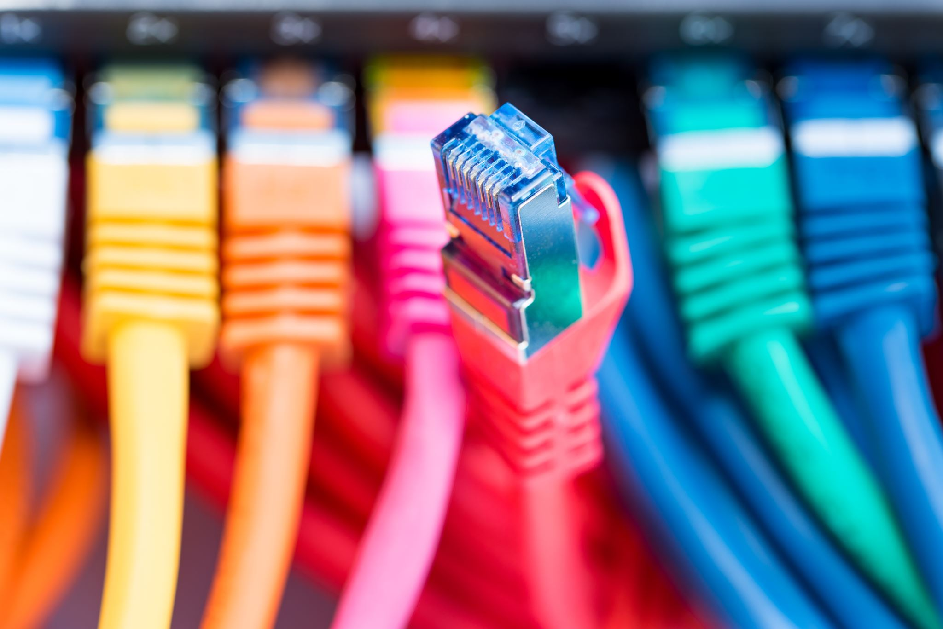
What is the Internet?
Learning outcomes
A global network of networks
It is the basic infrastructure that connects millions of computers around the world.
Content

Slide 5
Why Do We Connect Computers?
The main reason we connect computers together is to share information. such as:
Sending emails
Sharing files
Accessing websites
Remote access to other computers
To make this communication possible, we need protocols.

Slide 6
What Are Protocols?
Protocols are standard rules that control how data is sent and received across the internet.
Ways Information Can Be Shared Over the Internet:
📧 Email: Using protocols like POP3, IMAP, and SMTP
📂 File Transfer: Using FTP (File Transfer Protocol)
🔐 Remote Access: Using SSH (Secure Shell)
🌐 Web Browsing – using HTTP (Hypertext Transfer Protocol) or HTTPS (secure version)

Slide 7
What is the Web?
The Web (originally called the World Wide Web)
Is one way to share information over the internet.
The Web is different from the Internet —it's just one service that runs on top of it.
The web is a collection of documents accessible over the internet using a web browser.
Sharing this content also follows a communication protocol:
Hyper Text Transfer Protocol (HTTP)
Notes:
The web is the main focus of our module. The code we will produce (HTML, CSS and JavaScript) to build our websites will be accessed through the web
Internet vs. Web
Students often confuse these terms.
You need to repeat and emphasize:
The Internet = infrastructure.
The Web = one service that runs on top of the internet.

Slide 8
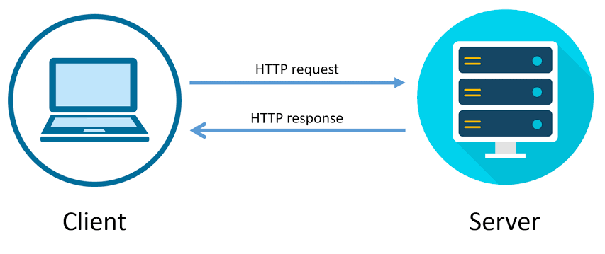
What is HTTP?
The client is the device that makes the request (user device)
The server is the device that provides a service (in this case, responds to the request)
Notes:
It tells your browser how to request and display web pages
Let’s talk more about the computers that make up the internet. Because they “serve up” documents upon request, these computers are known as servers. More accurately, the server is the software (not the computer itself) that allows the computer to communicate with other computers; however, it is common to use the word “server” to refer to the computer as well. The role of server software is to wait for a request for information, and then retrieve and send that information back as quickly as possible.
We now know that the server does the servin’, but what about the other half of the equation? The software that does the requesting is called the client. People use desktop browsers, mobile browsers, and other assistive technologies (such as screen readers) as clients to access documents on the web. The server returns the documents for the browser (also referred to as the user agent in technical circles) to display
The requests and responses are handled via the HTTP protocol

Slide 9
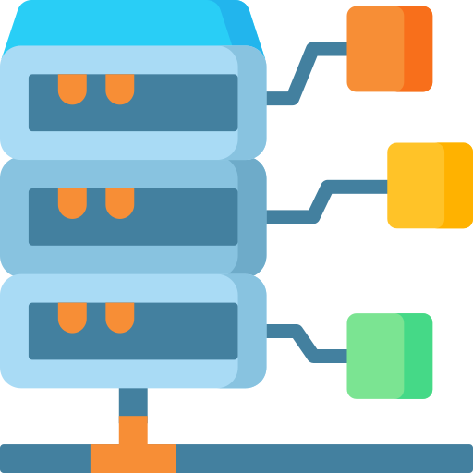
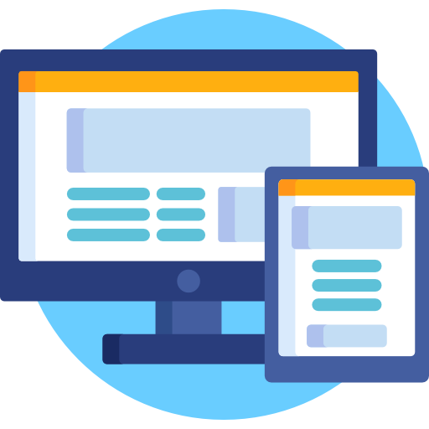
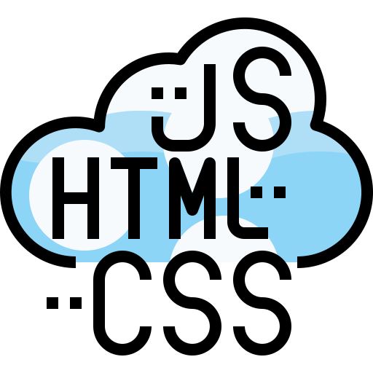


HTTP
Browser asks to the server
Server delivers to the browser
Browser renders into a website
FRONT-END
(what happens in the browser)
BACK-END
(what happens in the server)
Notes:
The requests and responses are handled via the HTTP protocol

Slide 10
The request is made through a Uniform Resource Locator (URL)
http://tudublin.ie/library/index.html
HTTP is the protocol
/library/index.html is the path to the file on the web server computer
tudublin.ie is the resource name
Notes:
Every page and resource on the web has its own special address called a URL, which stands for Uniform Resource Locator.

Slide 11
Requirements to build a website
Access to a PC or laptop
A connection to the Internet (to publish the site by sending it to the server)
An up-to-date web browser (Such as Mozilla Firefox or Google Chrome)
A text/code editor (such as Visual Code or Notepad++)

Slide 12
Website project planning
Before we create our web page, we need to plan it.
Ask yourself:
What is the theme for my website?
What will be the title for my webpage?
What content will be displayed on my page?
What can I add to the page to enhance the users' experience? [images / videos etc.]
What links could I add to the page that may be useful to the user?

Slide 13
What’s one website you use often, and what do you like about it?

Slide 14
The HTTP request the website from the server. What happens next?
Once the request is responded, the server will send a bunch of instructions to the browser, which will render into the website we want to see.

Slide 15
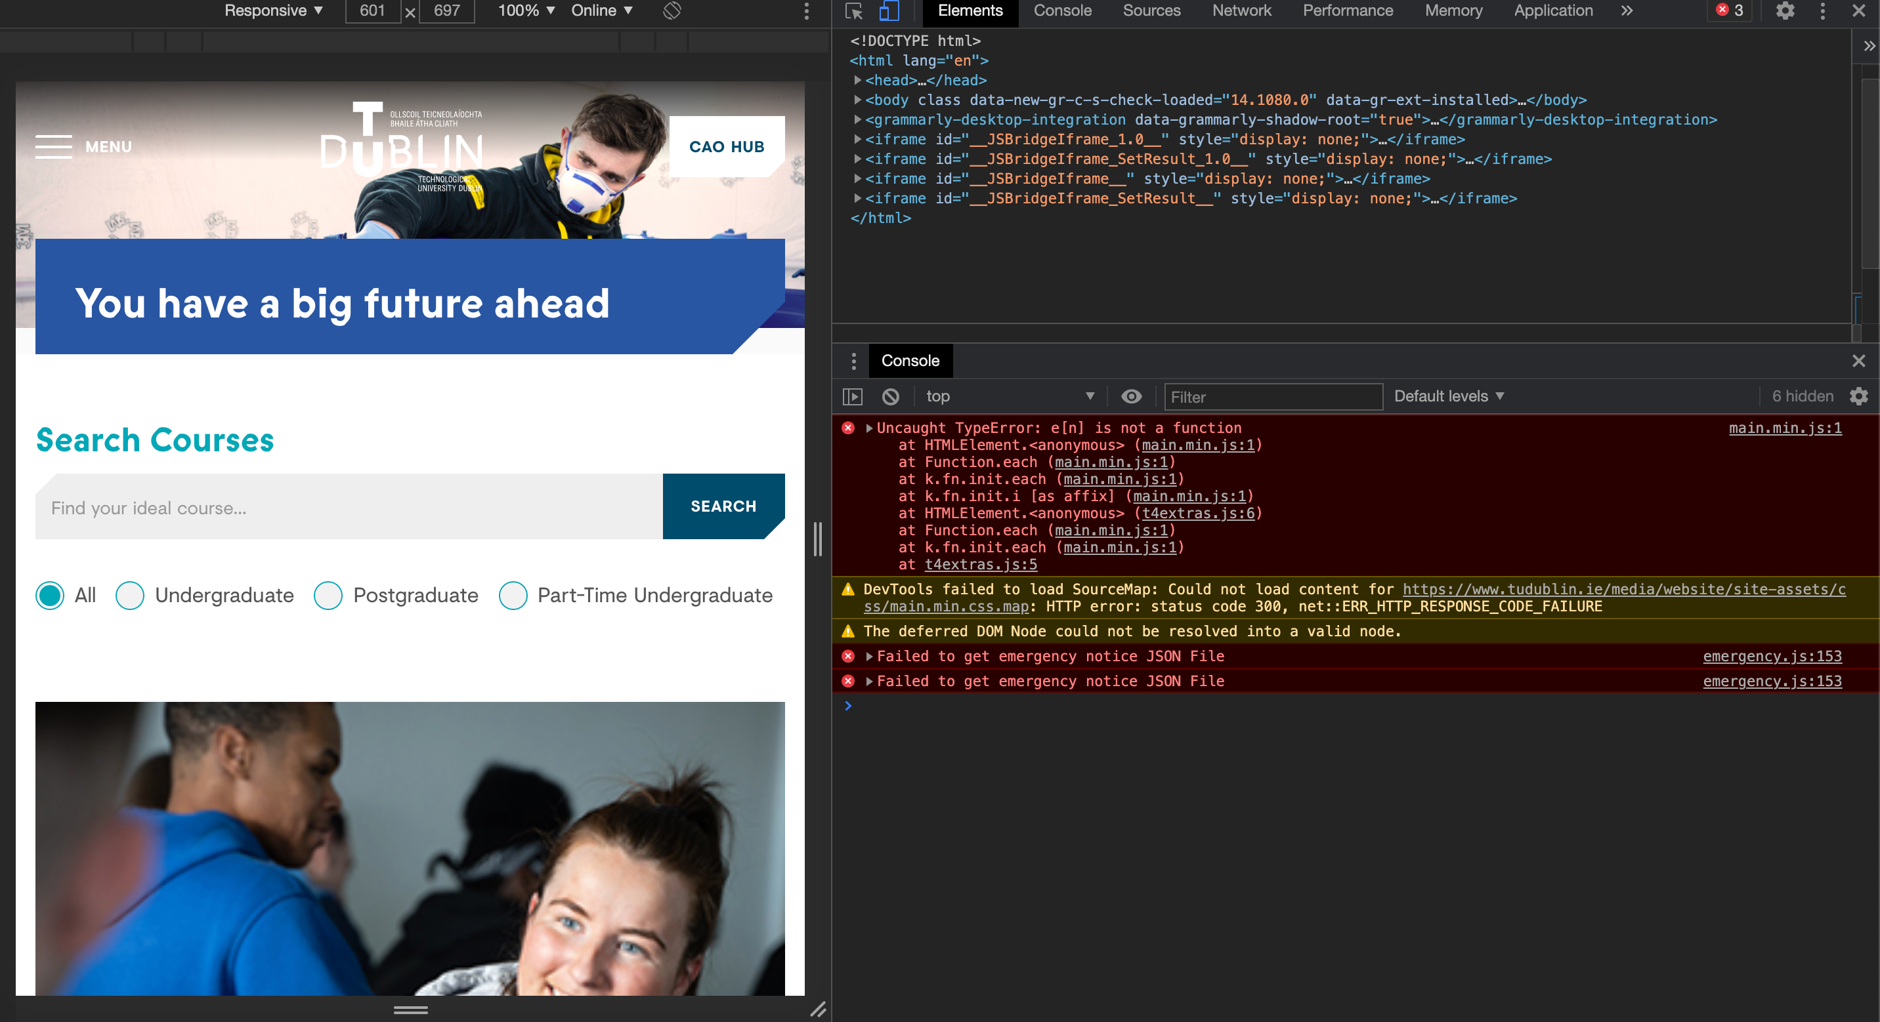
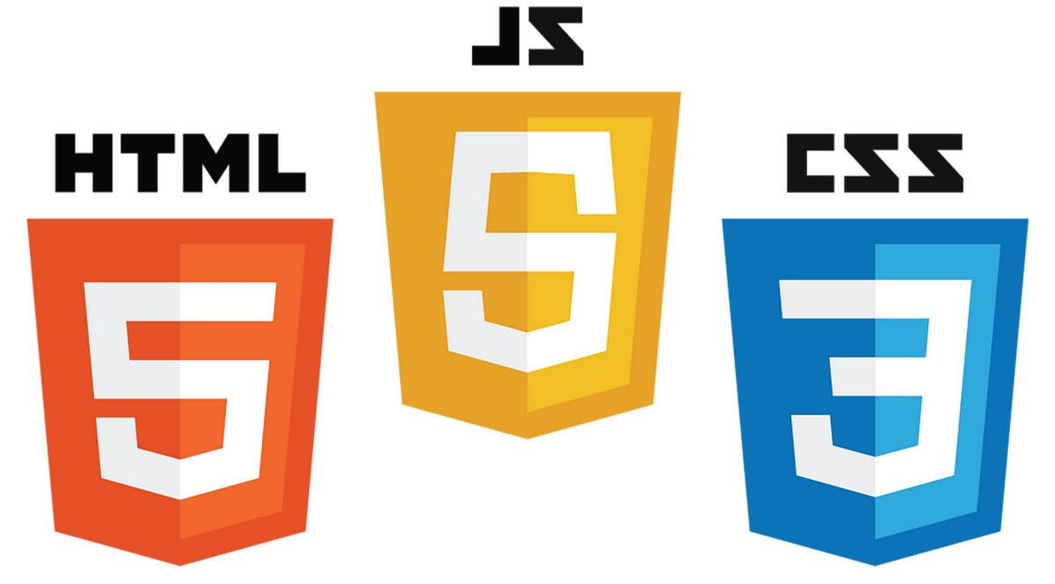
Page source

Slide 16
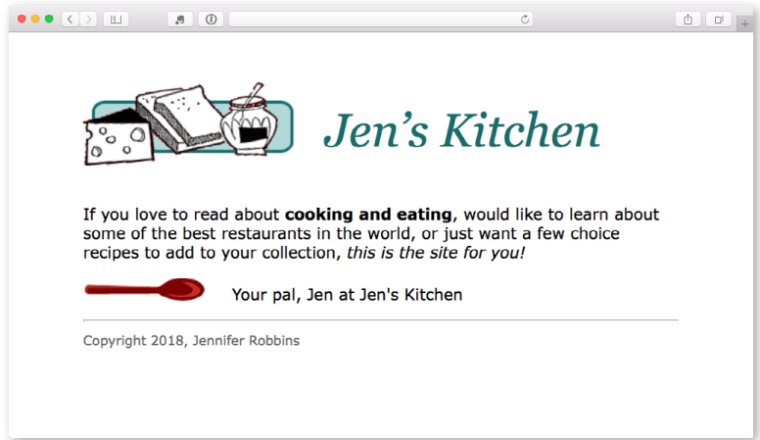
Notes:
The web page shown in this browser window consists of four separate files:
• An HTML text document
• A style sheet
• Two images
Tags in the HTML source document give the browsers instructions for how the text is structured and where the images should be placed

Slide 17
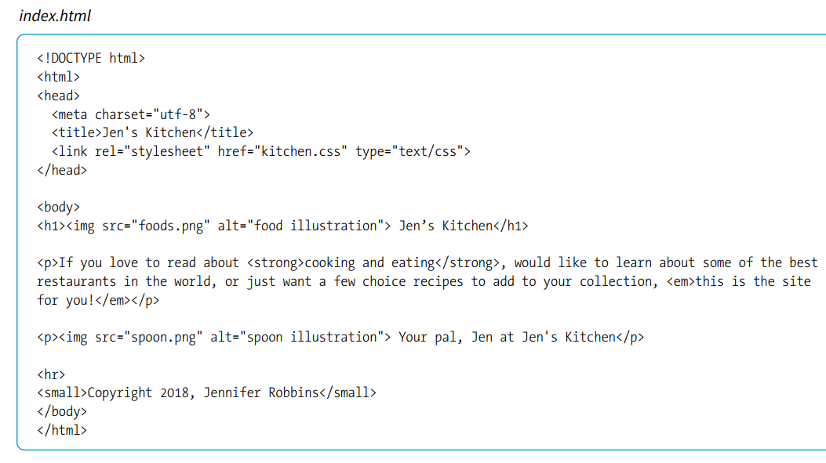

Slide 18
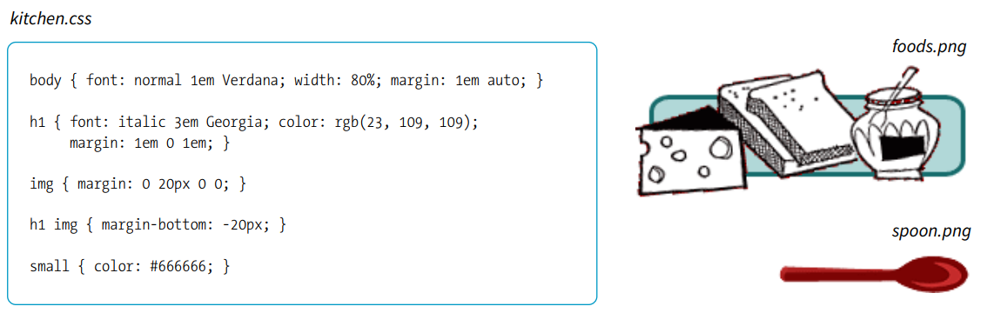

Slide 19
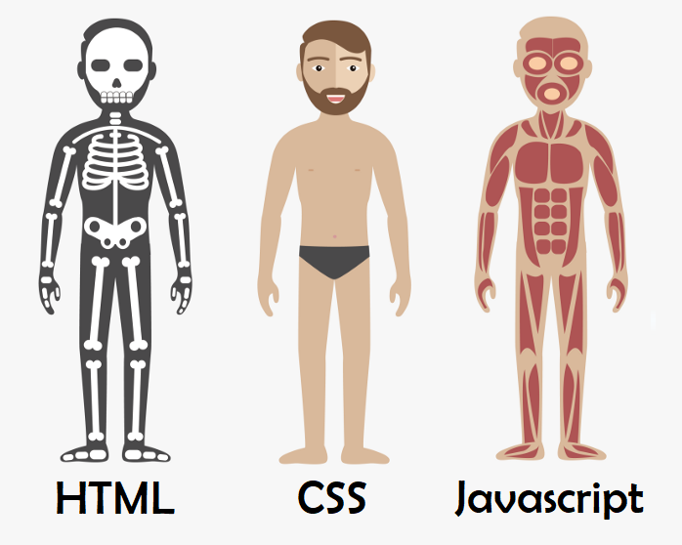
Notes:
Whereas HTML provides the structure and the CSS style sheet alters how things look, JavaScript adds a behavior component that controls how things work.

Slide 20

THE
ORANGE CSS - ADJECTIVES
CAT HTML - NOUNS
DANCED JAVASCRIPT - VERBS

Slide 21
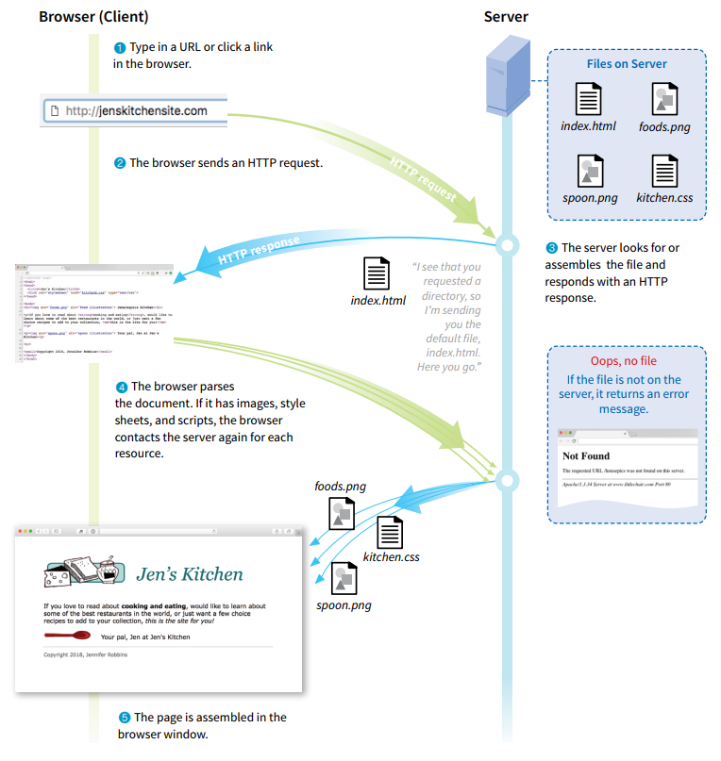

Slide 22
Developers x Users
Most of us may be very proficient at using the Internet but we will need to think a little differently when we are creating a website.
A website developer must understand what happens on the website from the users’ perspective before considering:
The layout of the site
What content is on which webpage
How will users get access to the content
Notes:
Before a web developer starts designing the website structure (layout, content placement, navigation), they need to think like a user — the person who will actually use the website.
Ask: “If I am a visitor, how will I use this site? What do I need?”
Example: A student visiting a university website wants to quickly find course information and contact details.

Slide 23
Cross platforms
No matter what type of device you are using, if you can access the Internet you will have access to the World Wide Web.
It doesn’t matter what Operating System the device is running.
Being able to use a particular technology or functionality on different operation systems (platforms) is described as Cross-Platform
Notes:
When we use the Internet, it doesn’t matter what type of device we are on—a laptop, a tablet, or a smartphone. As long as the device can connect to the Internet, we can access the World Wide Web. Likewise, it doesn’t matter what operating system the device is running, such as Windows, macOS, Linux, Android, or iOS.
This ability to use the same technology or functionality across different operating systems is called cross-platform compatibility (or simply cross-platform).

